Slide 1
Volusia County Data FY2017-18
Intakes - |  | 5435 | through April 30
Number of Children Removed - |  | 339 | through April 30
Number going to Non-judicial - |  | 495 | through March 31 - includes some post-OOHC reunification
Top 3 Maltreatments (thru April 30)
by Separate Maltreatment | # | % of all repts |  | including Combined Maltreatment* | # | % of all repts
Inadequate Supervision | 1287 | 25.8% |  | Substance Misuse | 1949 | 39.1%
Physical Injury | 1108 | 22.2% |  | Inadequate Supervision | 1287 | 25.8%
Household Violence Threatens Child | 1013 | 20.3% |  | Domestic Violence | 1253 | 25.2%
* combined maltreatments include all five for Substance Misuse and three for Domestic Violence

Slide 2
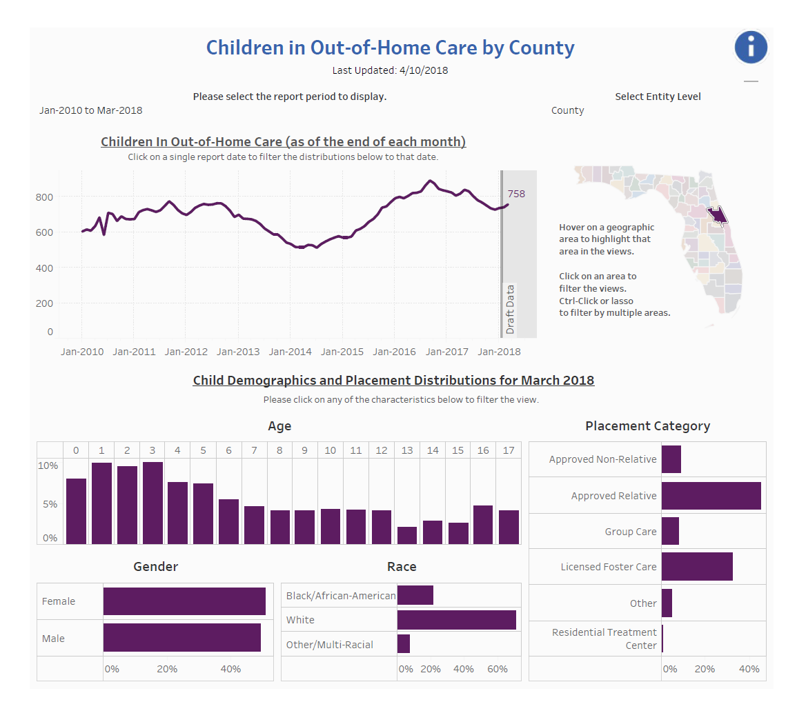

Slide 3
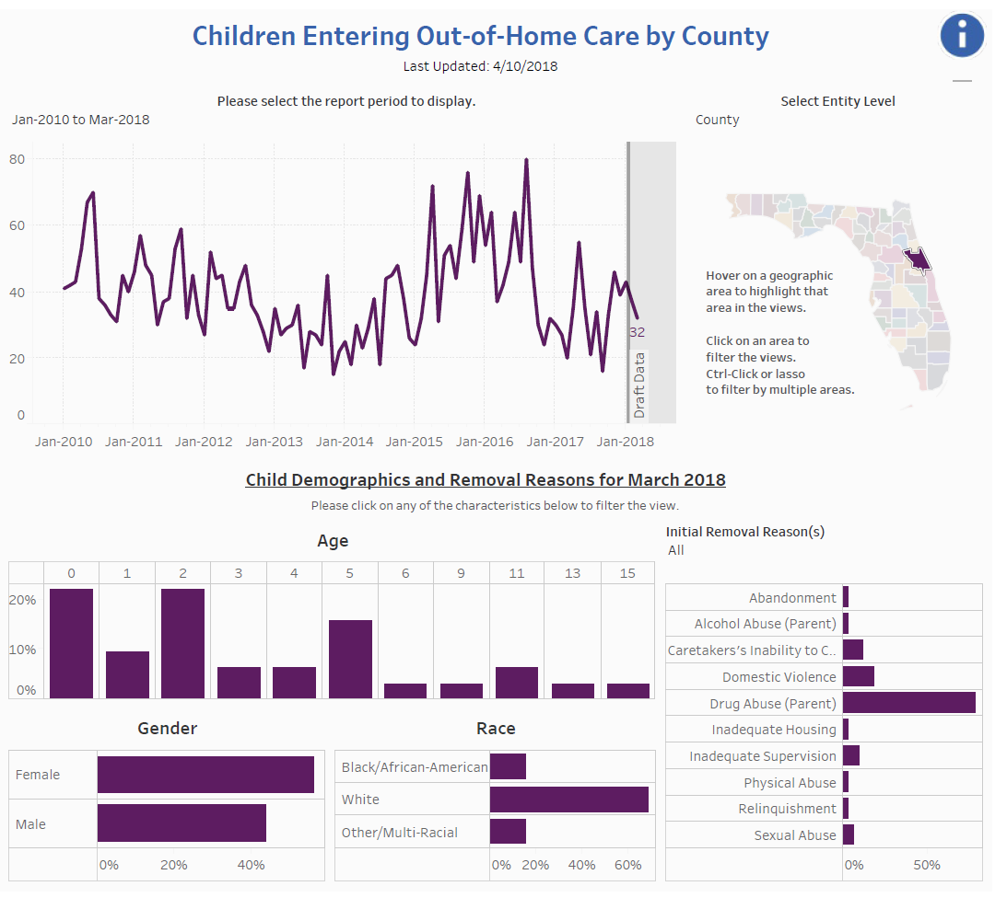

Slide 4
LRT Process
The purpose of a Local Review Team (LRT) Staffing is to resolve case specific conflicts that cannot be resolved at other Multidisciplinary Team Staffings (MDT/IPT).
Cases should be staffed through MDTs before being referred to the LRT Team
Examples: IPT (where available), HT staffing, CBC staffing, DJJ staffing, FSPT, etc.
Resolve Service Gaps
The LRT focus is on community children to prevent them from coming into care.
Types of Cases Referred
Baker Acts/Lockouts
DJJ Involved/Lockouts
Post Adoption Dissolutions
Unmet Mental Health/Substance Abuse/Behavioral Health Needs
Relative/Non-Relative placement will dissolve without additional support

Slide 5
LRT Process
Youth will be set up as an Emergency LRT or included on the Monthly LRT agenda.
Youth with continuing issues may be staffed monthly or more frequently based on needs.
Person requesting the LRT will be asked to present the youth’s case for discussion.
The expectation is that follow-up actions from the call will be reported back to the team
Success is based on participation by key agencies:
DCF, CBC, DJJ, SEDNET/Education, LSF/Community Mental Health Providers, AHCA, Medicaid Managed Care, GAL, Community Transition Teams and Family/Involved Caregivers

